Slide 1



Employee Management System (EMS)
Presented By:
Snigdha kola
Nazneen Begum
Jeevana Sri
Pravallika

Slide 2
Objective of the Project :
To develop a centralized database system to manage employee, department, payroll, qualification, and leave records efficiently.
To establish strong relationships between tables using primary and foreign keys to maintain data integrity.
To automate salary, bonus, and payroll calculations for accurate financial management.
To analyze employee performance, leave patterns, and department-wise salary distribution using SQL queries.
To generate meaningful reports that support management in effective decision-making.

Slide 3
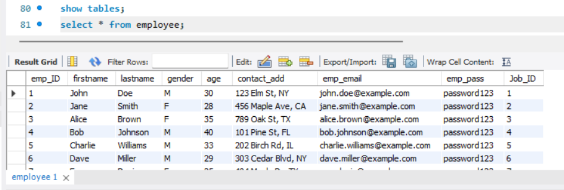
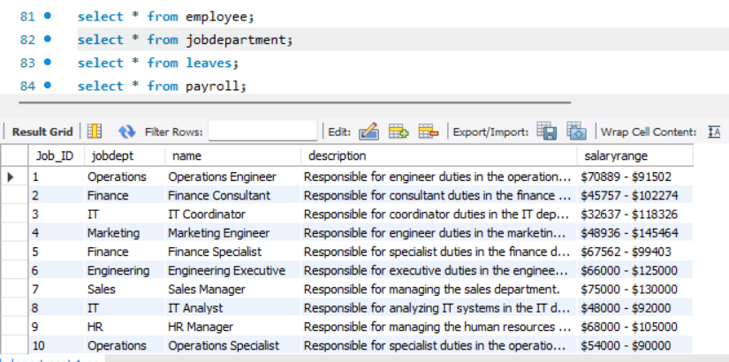
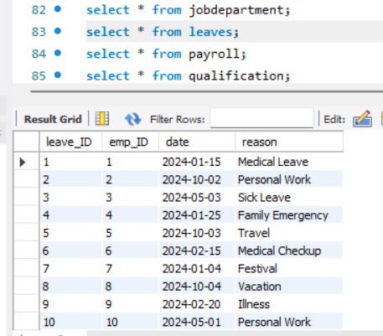
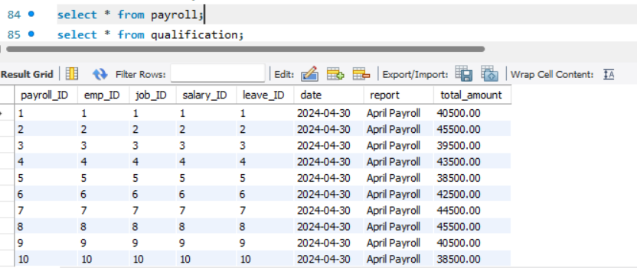
Database Overview :

Slide 4
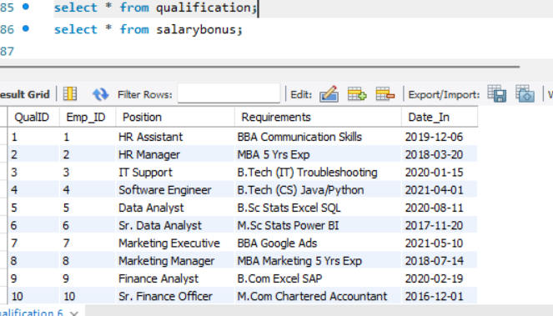
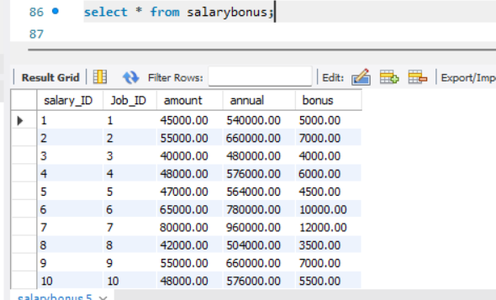
Database overview:

Slide 5
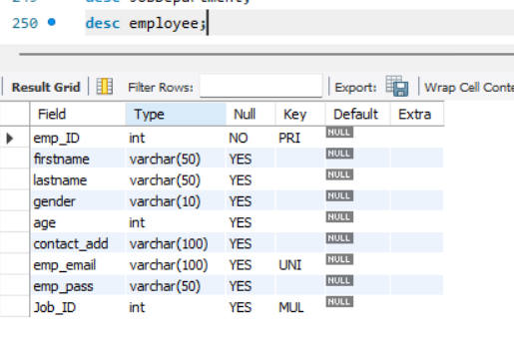
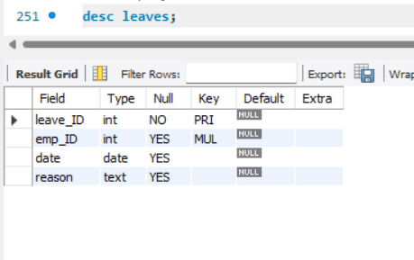
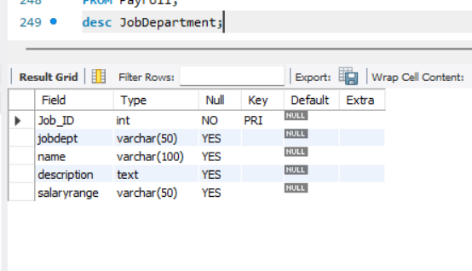
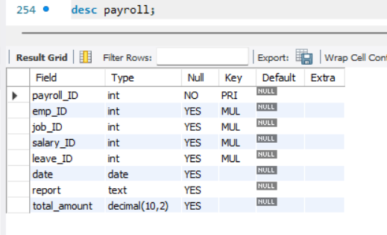
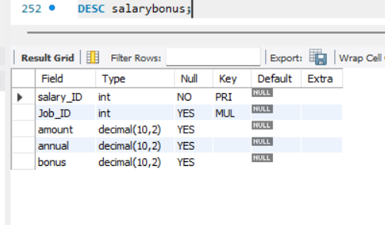
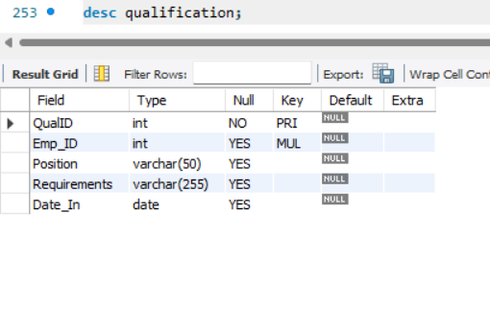
DATA OVERVIEW STRUCTURE:

Slide 6
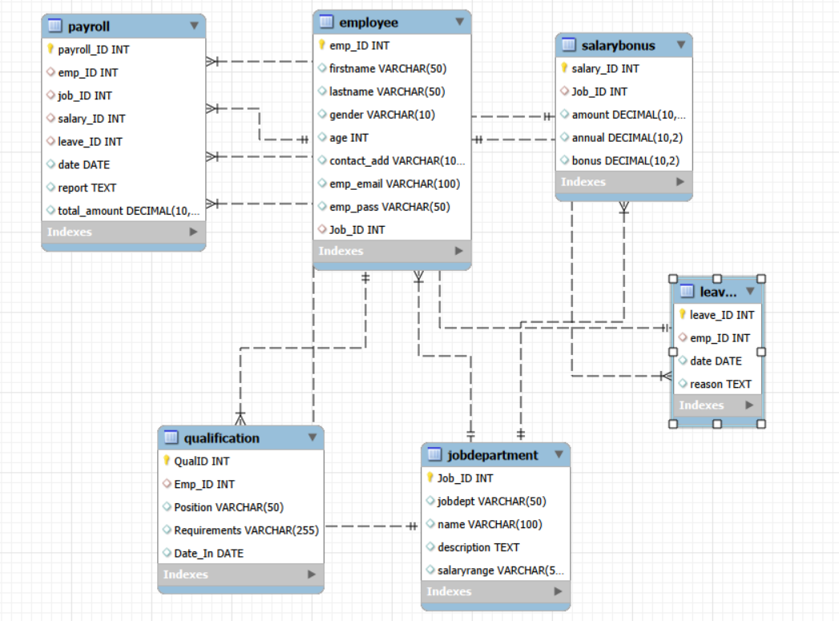
ER Diagram and schema explanation :

Slide 7
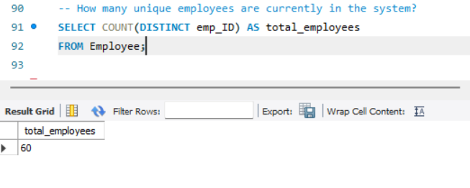
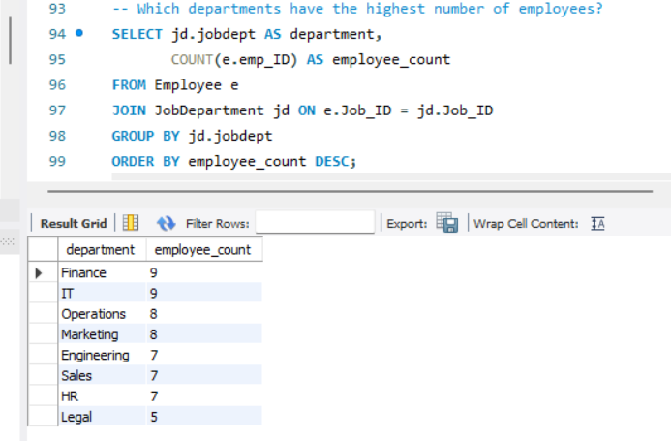
Employee Insights:
How many unique employees are currently in the system?
There are 60 unique employees currently in the system.
Which departments have the highest number of employees?
Finance and IT departments have the highest number of employees, with 9 employees each.

Slide 8
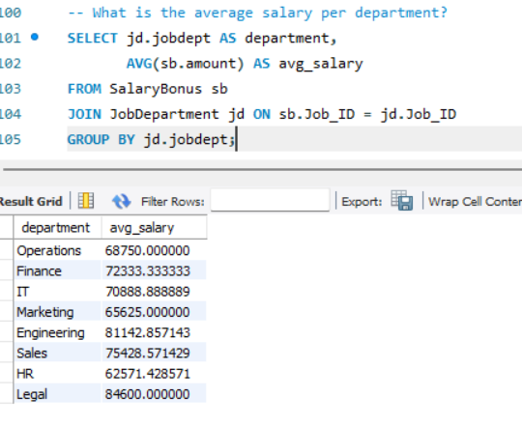
What is the average salary per department ?
The average salary varies by department, with Legal having the highest average salary (₹84,600), followed by Engineering (₹81,142.86) and Sales (₹75,428.57).

Slide 9
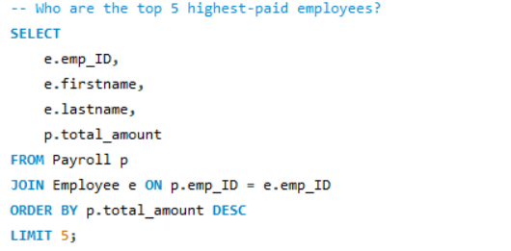
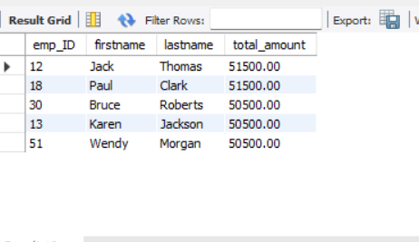
Who are the top 5 hightest- paid employee?
The top 5 highest-paid employees are Jack Thomas
and Paul Clark (₹51,500), followed by Bruce Roberts, Karen Jackson, and Wendy Morgan (₹50,500).

Slide 10
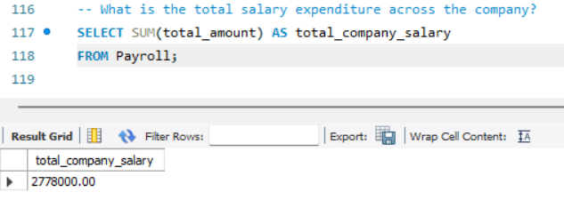
What is the total salary expenditure across the company?
The total salary expenditure across the company is ₹27,78,000, calculated using the SUM(total_amount) function on the Payroll table.

Slide 11
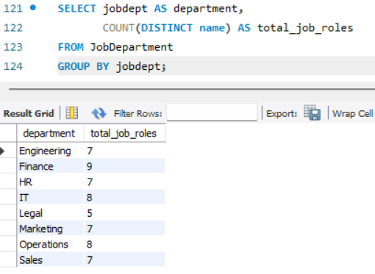
JOB ROLE AND DEPARTMENT ANALYSIS:
The Finance department has the highest number of distinct job roles (9), followed by IT and Operations (8 each), indicating greater role diversity in these departments.

Slide 12
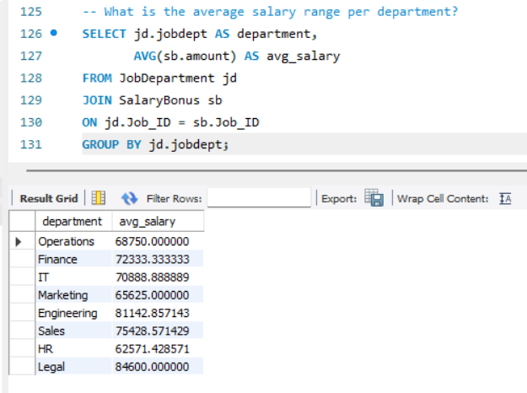
What is the average salary range per department?
Legal (₹84,600) and Engineering (₹81,143) have the highest average salaries, while HR (₹62,571) has the lowest, indicating variation in pay structure across departments.

Slide 13
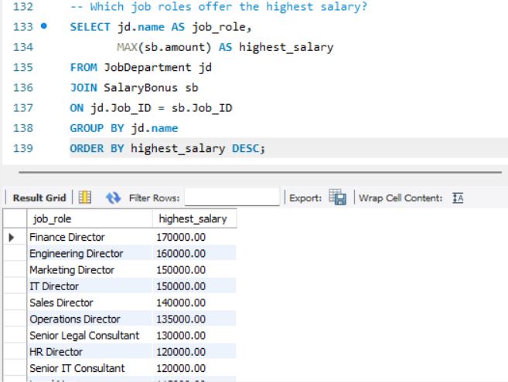
Which job roles offer the highesr salary?
Finance Director receives the highest salary (₹1,70,000).
Director-level roles offer the top pay across departments.
Senior roles have significantly higher salaries than other positions.

Slide 14
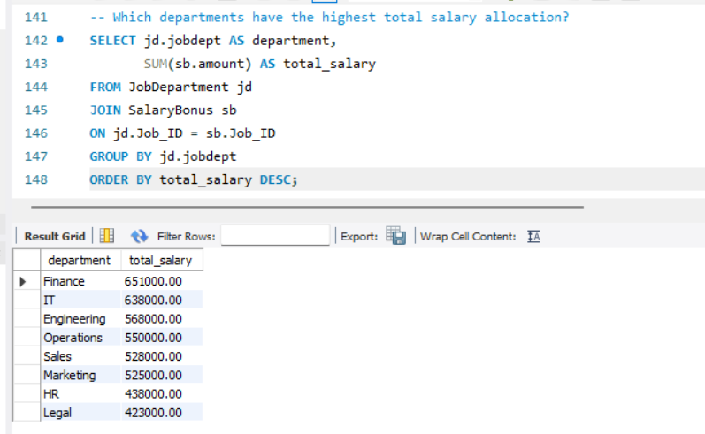
Which departments have the highest total salary allocation?
Finance has the highest total salary allocation (₹6,51,000), followed by IT (₹6,38,000).
Legal (₹4,23,000) and HR (₹4,38,000) have the lowest total salary allocations.
Salary distribution varies significantly across departments, with Finance leading overall expenditure.

Slide 15
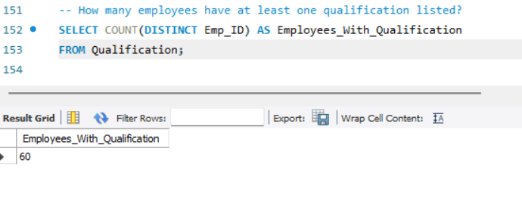
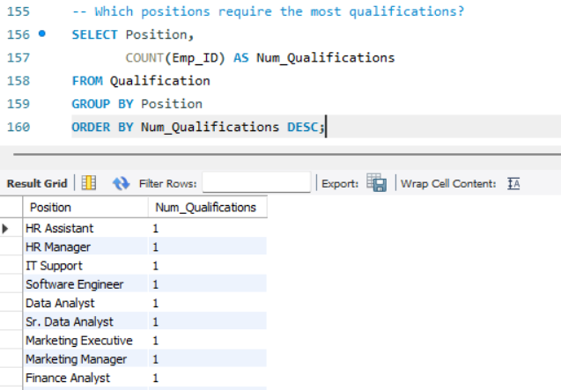
QUALIFICATION AND SKILLS ANALYSIS :
How many employees have at least one qualification listed ?
A total of 60 employees have at least one qualification listed in the system.
Which positions require the most qualification?
All listed positions currently show 1 qualification each, indicating no position requires more qualifications than others in the dataset.

Slide 16
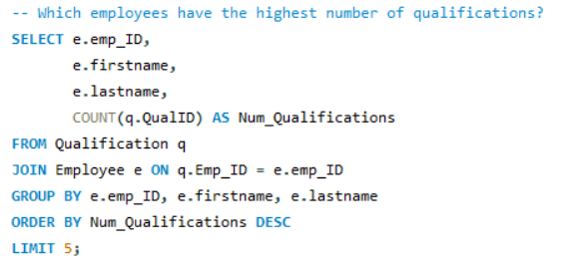
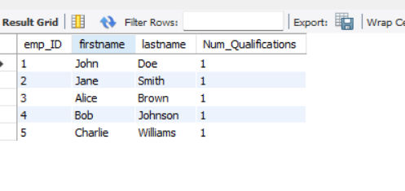
Which employees have the highest number of qualifications?
The top employees (John Doe, Jane Smith, Alice Brown, Bob Johnson, and Charlie Williams) each have 1 qualification, indicating no employee has more qualifications than others in the dataset.

Slide 17
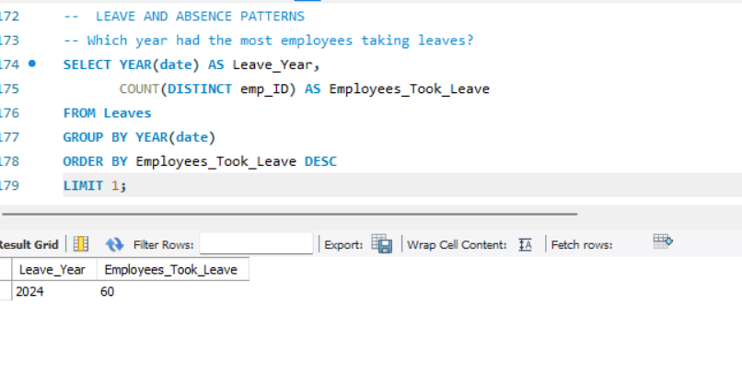
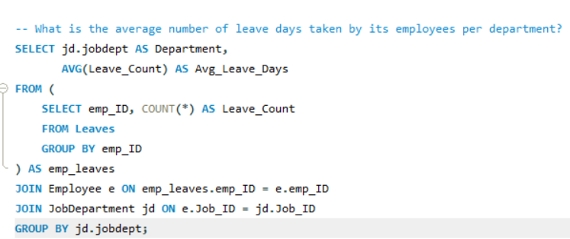
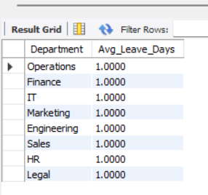
Leave and Absence patterns :
Which year had the most employees taking leaves?
2024 recorded the highest employee leave count, with 60 employees taking leave — indicating a peak in absence trends during this year.
What is the average number of leave days taken by its employees per department?
All departments show an average of 1 leave day per employee, indicating a consistent leave pattern across the organization.

Slide 18
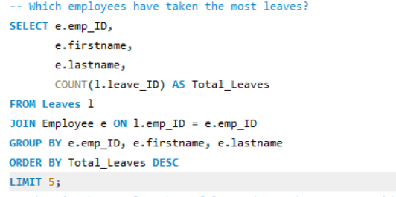
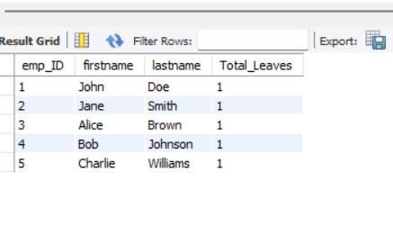
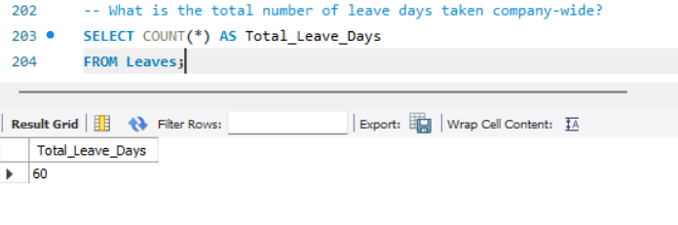
Which employees have taken the most leaves?
John Doe, Jane Smith, Alice Brown, Bob Johnson, and Charlie Williams have taken the most leaves, each with 1 leave recorded (no single employee stands out with higher leave count).
A total of 60 leave days have been taken company-wide, reflecting the overall absence level across the organization.
What is the total number of leave days taken company- wide?

Slide 19
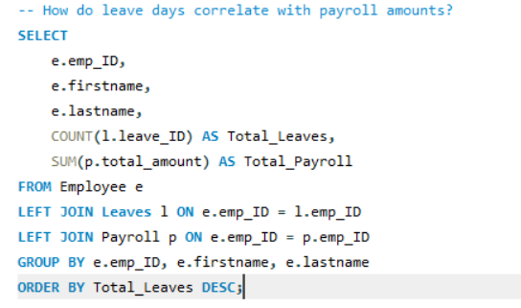
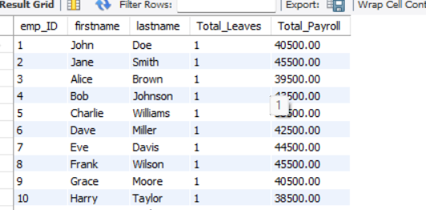
How do leave days coorelate with payroll amounts?
There is no visible correlation between leave days and payroll amounts, as all employees have taken 1 leave day while payroll amounts vary across individuals.

Slide 20
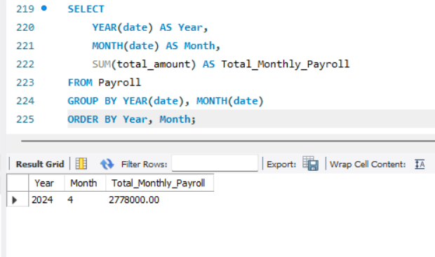
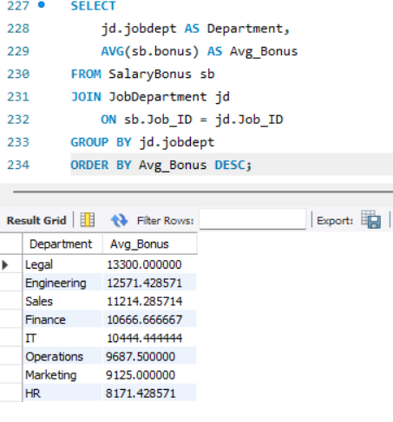
PAYROLL AND COMPENSATION ANALYSIS:
Monthly payroll is aggregated by year and month, showing the total payroll amount paid each month to track salary trends over time.
In April 2024, the total monthly payroll amounted to 2,778,000, indicating a significant salary expenditure for that month.
What is the average bonus given per department?
Average bonus varies by department, with some departments receiving higher incentive payouts than others, highlighting differences in performance-based rewards.

Slide 21
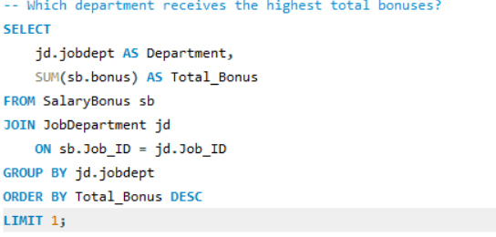
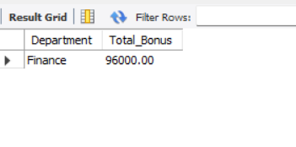
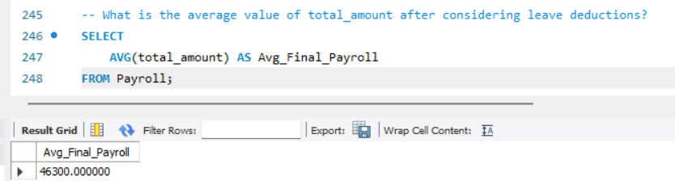
Which department receives the highest total bonuses?
The department at the top of the result receives the highest total bonus payout, indicating it has the largest overall incentive allocation in the company.
The Finance department receives the highest total bonus, amounting to 96,000, indicating it has the largest overall incentive payout.
What is the average value of total_amount after considering leave deduction?
The average final payroll amount represents the typical salary payout per payroll record across the organization.
The average final payroll amount is 46,300, indicating the typical salary payout per payroll cycle.

Slide 22
Overall insights:
The database integrates Employee, Department, Salary, Bonus, Leave, Qualification, and Payroll data into a structured HR management system.
Workforce distribution across departments is balanced, supporting efficient organizational operations.
The average payroll amount (₹46,300) indicates a stable and consistent compensation structure.
Monthly payroll analysis (e.g., ₹27,78,000 in April 2024) helps track company salary expenditure trends.
The Finance department records the highest total bonus payout (₹96,000), showing strong incentive allocation.
Department-wise salary and bonus variations highlight performance-based reward differences.
Leave analysis shows controlled absenteeism, with no extreme leave patterns affecting payroll significantly.
Qualification tracking and top-paid employee analysis enable strategic HR decisions in promotions, budgeting, and workforce planning.

Slide 23
Conclusion:
The project successfully integrates employee, payroll, leave, department, and qualification data into one structured system.
SQL queries provide meaningful insights into salary trends, bonuses, and workforce distribution
Payroll analysis helps monitor monthly expenditure and average compensation levels.
Bonus and salary comparisons support performance-based evaluation.
Leave tracking ensures better attendance monitoring and payroll accuracy.
Qualification analysis helps identify skilled employees and role requirements.
The system improves data accuracy through proper primary and foreign key relationships.
Overall, the project enhances HR decision-making, transparency, and organizational efficiency.

Slide 24

THANK YOU

